Slide 1
Numerical analysis of coupled mode conversion in plasma with sheared magnetic field
Xinhang Xu
8/6/2024

Slide 2
Abstract
Motivation
Research steps
General equation for analyzing the coupled mode conversion
Numerical method
Numerical benchmark with typical case
Propagation in the sheared magnetic field
Mode-conversion analysis
Summary

Slide 3


Motivation
FIRTIP
High k Scattering diagnose
Launch mode
Right rotation polarization
&
Left rotation polarization
Linear polarization mode
Spherical Tokamak
Faraday rotation in Sheard magnetic field
The phase might be shift by the sheared magnetic field, adding the error in the electron density measurement
The scattering polarization is strongly correlated with the launch beam polarization, which will influent our receiver intensity

Slide 4


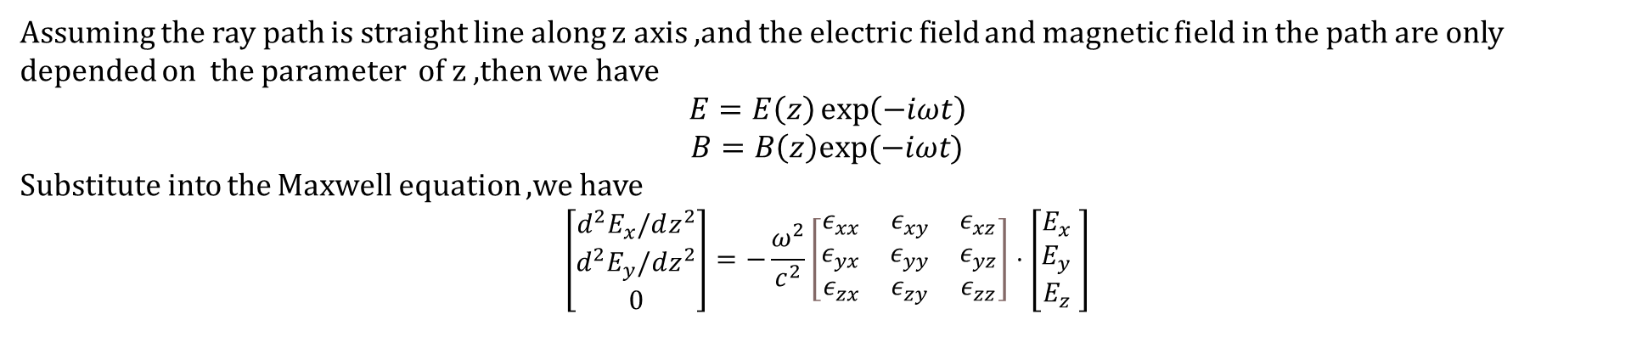
General equation
According to the Maxwell equations, we have
$$∇×B=μ_{0}ε_{0}\overset{̿}{ε}⋅\frac{∂E}{∂t}$$
$$∇×E=−\frac{∂B}{∂t}$$
$$\overset{̿}{ε}=\left[\begin{matrix}ε_{xx} & ε_{xy} & ε_{xz} \\ ε_{yx} & ε_{yy} & ε_{yz} \\ ε_{zx} & ε_{zy} & ε_{zz}\end{matrix}\right]$$
where
Assuming the ray path is straight line along z axis ,and the electric field and magnetic field in the path are only depended on the parameter of z ,then we have
$$E=E\left(z\right)\exp\left(−iωt\right)$$
$B=B\left(z\right)exp⁡(−iωt)$
Substitute into the Maxwell equation ,we have
$$\left[\begin{matrix}d^{2}E_{x}/dz^{2} \\ d^{2}E_{y}/dz^{2} \\ 0\end{matrix}\right]=−\frac{ω^{2}}{c^{2}}\left[\begin{matrix}ε_{xx} & ε_{xy} & ε_{xz} \\ ε_{yx} & ε_{yy} & ε_{yz} \\ ε_{zx} & ε_{zy} & ε_{zz}\end{matrix}\right]⋅\left[\begin{matrix}E_{x} \\ E_{y} \\ E_{z}\end{matrix}\begin{matrix} \\ \\ \end{matrix}\right]$$

Slide 5
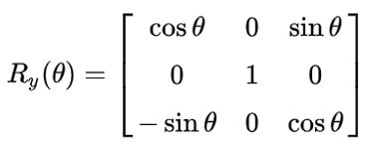
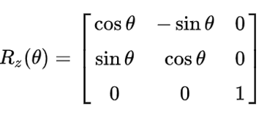
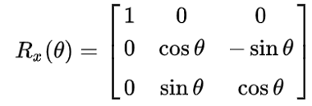
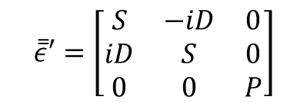
General equation
In cold plasma with magnetic field along z axis,the dielectric tensor can be expressed as
$$\overset{̿}{ε}′=\left[\begin{matrix}S & −iD & 0 \\ iD & S & 0 \\ 0 & 0 & P\end{matrix}\right]$$
If the magnetic field direction change to new direction ,the rotation angle can be expressed as Rc=Rz*Ry*Rx
Then the dielectric tensor is
$$\overset{̿}{ε}=Rc∗{\overset{̿}{ε}}^{′}∗Rc′$$
Rc’ means inverse matrix of Rc

Slide 6
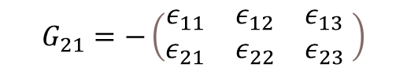
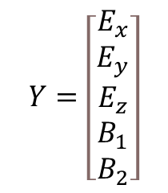
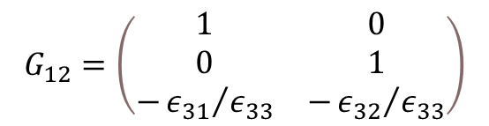
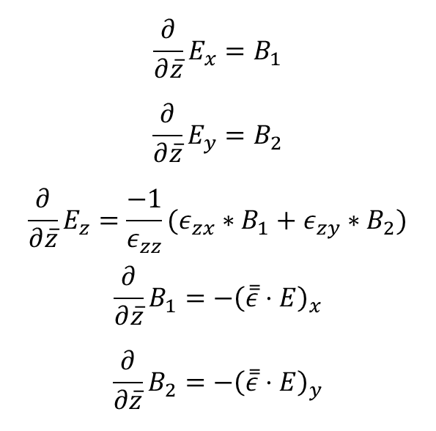
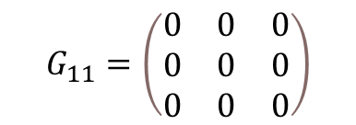
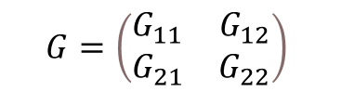

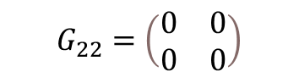
Numerical method
$$\frac{∂}{∂\overline{z}}E_{x}=B_{1}$$
$$\frac{∂}{∂\overline{z}}E_{y}=B_{2}$$
$$\frac{∂}{∂\overline{z}}E_{z}=\frac{−1}{ε_{zz}}(ε_{zx}∗B_{1}+ε_{zy}∗B_{2})$$
$$\frac{∂}{∂\overline{z}}B_{1}=−{\left(\overset{̿}{ε}⋅E\right)}_{x}$$
$$\frac{∂}{∂\overline{z}}B_{2}=−{\left(\overset{̿}{ε}⋅E\right)}_{y}$$
We can write the formula as $\frac{dY}{d\overline{z}}=GY$
$$Y=\left[\begin{matrix}E_{x} \\ E_{y} \\ E_{z} \\ B_{1} \\ B_{2}\end{matrix}\right]$$
$$G=\left(\begin{matrix}G_{11} & G_{12} \\ G_{21} & G_{22}\end{matrix}\right)$$
(Gauss Law)
$$G_{11}=\left(\begin{matrix}0 & 0 & 0 \\ 0 & 0 & 0 \\ 0 & 0 & 0\end{matrix}\right)$$
$$G_{12}=\left(\begin{matrix}\begin{matrix}1 & 0 \\ 0 & 1 \\ −{ε_{31}}/{ε_{33}} & −{ε_{32}}/{ε_{33}}\end{matrix}\end{matrix}\right)$$
$$G_{21}=−\left(\begin{matrix}ε_{11} & ε_{12} & ε_{13} \\ ε_{21} & ε_{22} & ε_{23}\end{matrix} \right)$$
$$G_{22}=\left(\begin{matrix}0 & 0 \\ 0 & 0\end{matrix}\right)$$

Slide 7



Crank-Nicolson method for $\frac{dY}{d\overline{z}}=GY$
$$Y^{n+1}−Y^{n}=\frac{1}{2}Δ\overline{z}G\left(Y^{n+1}+Y^{n}\right)$$
$$\left(I−\frac{1}{2}Δ\overline{z}G\right)Y^{n+1}=\left(I+\frac{1}{2}Δ\overline{z}G\right)Y^{n}$$
Iteration function is
$$Y^{n+1}={\left(I−\frac{1}{2}Δ\overline{z}G\right)}^{−1}∗\left(I+\frac{1}{2}Δ\overline{z}G\right)Y^{n}$$

Slide 8
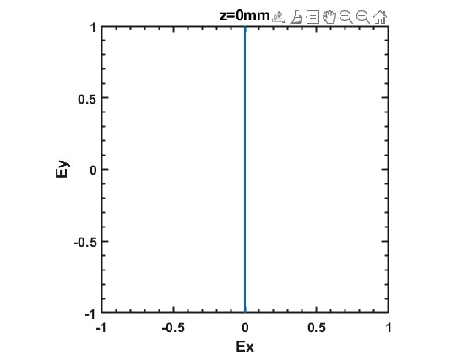
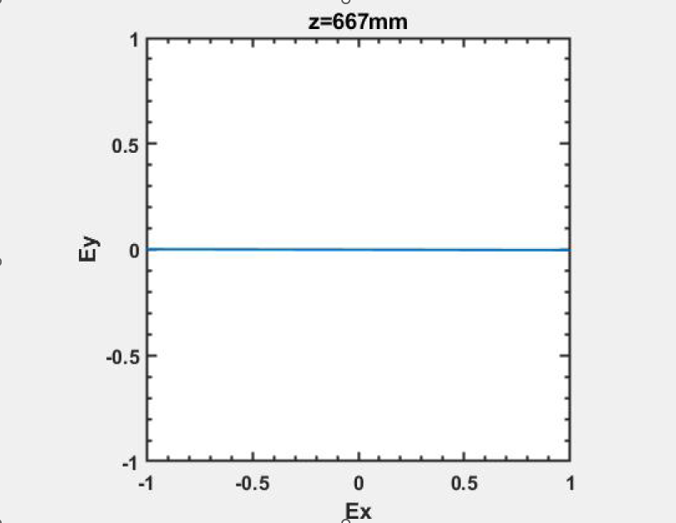
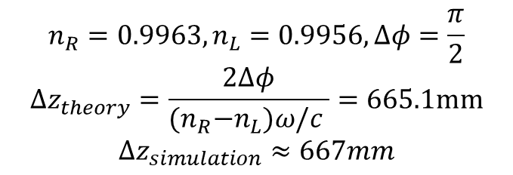
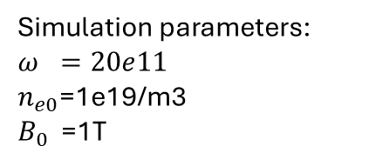
Numerical benchmark with typical case
1. Faraday Rotation
B0
k
E
Simulation parameters:
$$ω =20e11$$
$n_{e0}$=1e19/m3
$B_{0}$ =1T
$$n_{R}=0.9963,n_{L}=0.9956,Δφ=\frac{π}{2}$$
$$Δz_{theory}=\frac{2Δφ}{{(n}_{R}−n_{L})ω/c }=665.1mm$$
$$Δz_{simulation}≈667mm$$

Slide 9
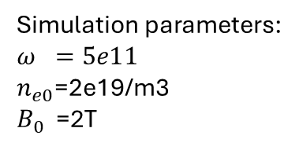
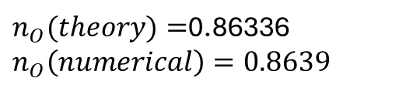
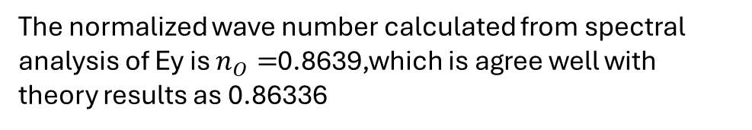
2. X mode and O mode
O mode
k
E
B₀
Simulation parameters:
$$ω =5e11$$
$n_{e0}$=2e19/m3
$B_{0}$ =2T
$n_{O}(theory)=$0.86336
$$n_{O}\left(numerical\right)=0.8639$$
The normalized wave number calculated from spectral analysis of Ey is $n_{O}=$0.8639,which is agree well with theory results as 0.86336

Slide 10
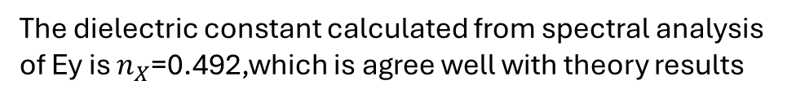
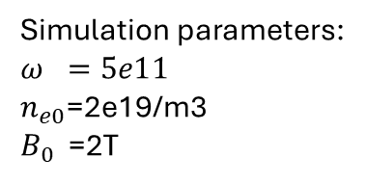
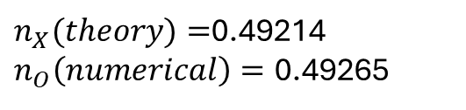
2. X mode and O mode
X mode
k
E
B₀
Simulation parameters:
$$ω =5e11$$
$n_{e0}$=2e19/m3
$B_{0}$ =2T
$n_{X}(theory)=$0.49214
$n_{O}\left(numerical\right)=\text{0.492}$65
The dielectric constant calculated from spectral analysis of Ey is $n_{X}$=0.492,which is agree well with theory results

Slide 11
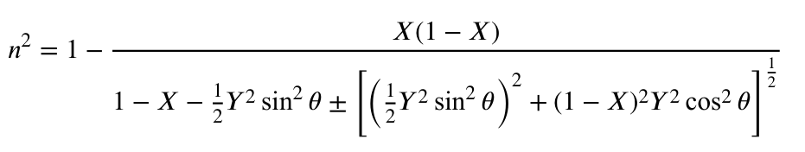
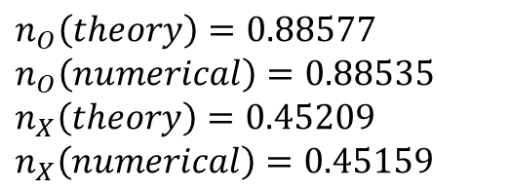
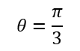
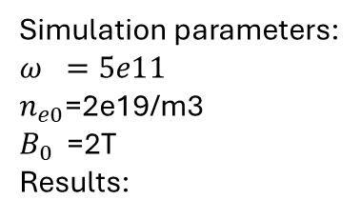
Oblique propagation
k
E
$$θ=\frac{π}{3}$$
B₀
Simulation parameters:
$$ω =5e11$$
$n_{e0}$=2e19/m3
$B_{0}$ =2T
Results:
fft
$$n_{O}\left(theory\right)=0.88577$$
$$n_{O}\left(numerical\right)=0.88535$$
$$n_{X}\left(theory\right)=0.45209$$
$$n_{X}\left(numerical\right)=0.45159$$

Slide 12
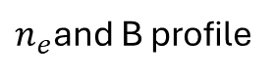
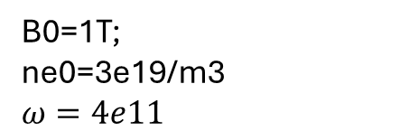
Cutoff layer
$n_{e}$and B profile
k
B₀
B0=1T;
ne0=3e19/m3
$$ω=4e11$$
Eo field forms a standing wave and is blocked at the boundary of cutoff layer ,while Ex field is not blocked
Refractive index of O mode and X mode

Slide 13

Strange phenomenon
k
$$β$$
B₀
K always parallel to z
omega =3e11;
ne0=5e19;
B0 =1;
beta= pi/3.0;

Slide 14
Strange phenomenon
Cutoff layer
Resonant layer
When the cutoff layer close to resonant layer of X mode , the electrostatic field near the resonant layer will be very strong within certain oblique angle range , why ?

Slide 15
Backup case

Slide 16
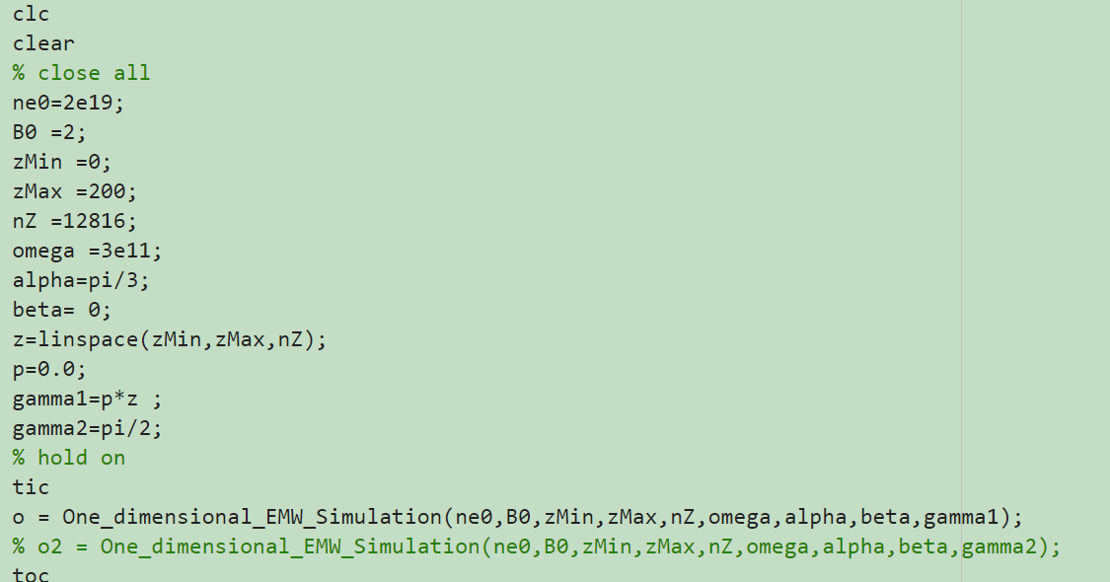

Slide 17
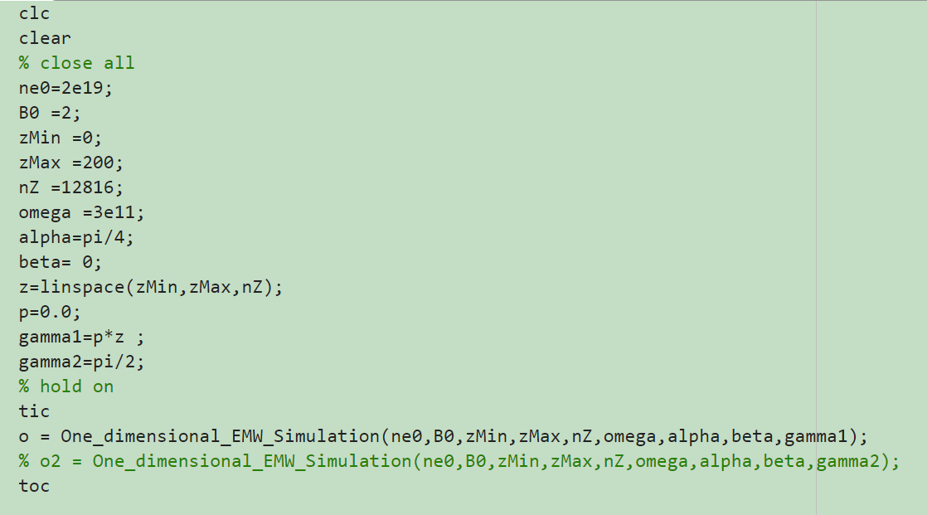

Slide 18
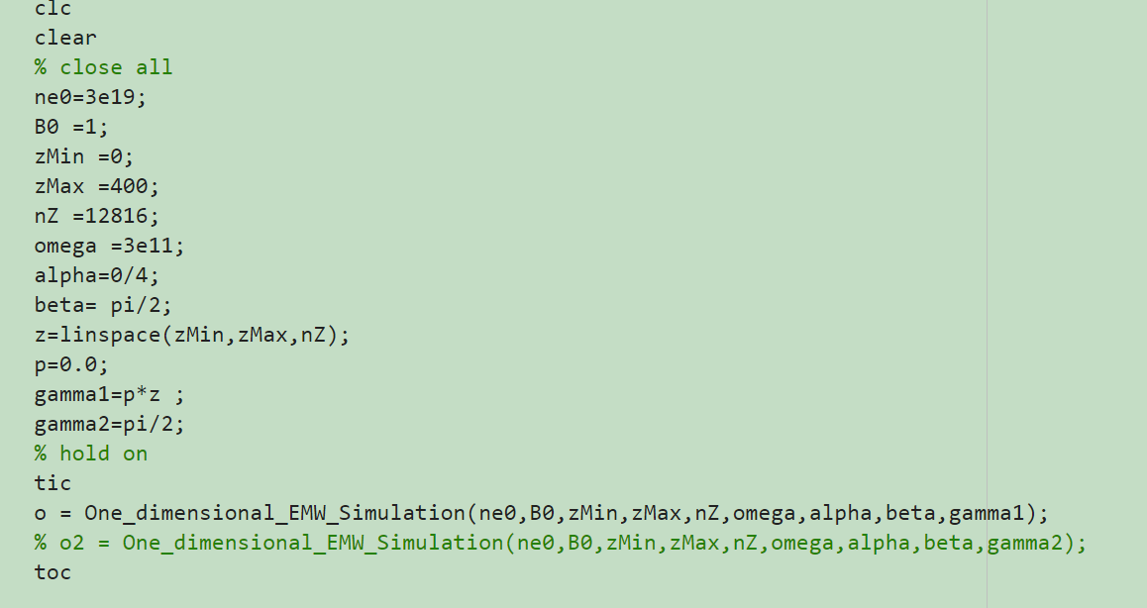

Slide 19
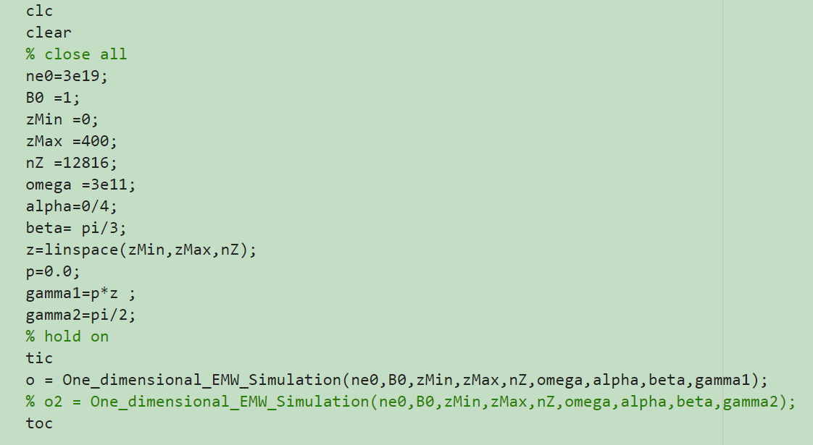

Slide 20
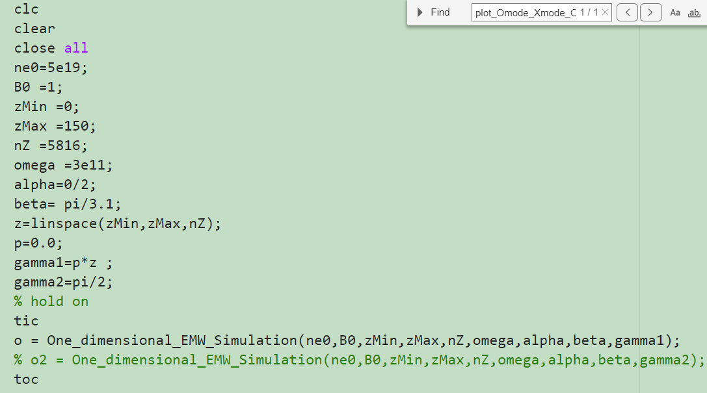
One Strange Phenomenon near the cutoff and resonant layer

